Slide 1
MASTERS IN PROJECT MANAGEMENT
PROJECT RISK
MANAGEMENT
Class: MS(PM)-2(A,B&C)

Slide 2
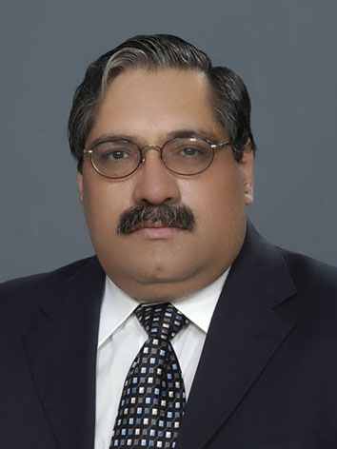
Instructor
Suhail Iqbal
PE, PMP, PgMP, PME, MCT, PRINCE2 Practitioner.
PE, PMP, PgMP, PME, MCT, PRINCE2 Practitioner.
Notes:
Custom animation effects: horizontal scrolling text
(Basic)
To reproduce the text effects on this slide, do the following:
On the Home tab, in the Slides group, click Layout, and then click Blank.
On the Insert tab, in the Text group, click Text Box, and then on the slide, drag to draw the text box.
Enter text in the text box. (Note: You may want to add a bullet point at the end of your text, as in the example above. On the Insert tab, in the Text group, click Symbol. In the Symbol dialog box, in the Font list, select (normal text). In the Subset list, select General Punctuation. In the Character Code box, enter 2022 to select BULLET, and then click Insert.)
Select the text. On the Home tab, in the Font group, do the following:
In the Font list, select Gill Sans MT.
In the Font Size list, select 36.
Click Bold.
Click the arrow next to Font Color, and then under Theme Colors click White, Background 1 (first row, first option from the left).
On the Home tab, in the Paragraph group, click Align Text Left to align the text left in the text box. (Note: If the text wraps to more than one line, drag the adjustment handles on the text box to widen it until the text fits on one line.)
Drag the text box to the left of the lower left edge of the slide. (Note: To see beyond the edges of the slide, on the View tab, click Zoom, and then in the Zoom dialog box, in the Percent box, enter 40%.)
To reproduce the animation effects on this slide, do the following:
On the Animations tab, in the Animations group, click Custom Animation.
On the slide, select the text box. In the Custom Animation task pane, do the following:
Click Add Effect, point to Entrance, and then click More Effects. In the Add Entrance Effect dialog box, under Basic, click Fly In.
Select the animation effect (fly-in effect for the text box). Click the arrow to the right of the select effect, and then click Effect Options. In the Fly In dialog box, do the following:
On the Effect tab, in the Direction list, select From Right.
On the Timing tab, do the following:
In the Start list, select With Previous.
In the Speed box, enter 16 seconds.
In the Repeat list, select Until End of Slide.
On the slide, select the text box. On the Home tab, in the Clipboard group, click the arrow under Paste, and then click Duplicate.
In the Custom Animation task pane, select the second animation effect (fly-in effect for the second text box). Click the arrow to the right of the selected effect, and then click Timing. In the Fly In dialog box, on the Timing tab, in the Delay box, enter 8. (Note: You may need to adjust the delay time if the length of your text is different than the example above.)
On the slide, drag the second text box on top of the first text box.
On the Home tab, in the Editing group, click Select, and then click Selection Pane.
In the Selection and Visibility pane, press and hold CTRL, and then select both text boxes. On the Home tab, in the Drawing group, click Arrange, point to Align, and then do the following:
Click Align Selected Objects.
Click Align Middle.
Click Align Center.
To reproduce the background effects on this slide, do the following:
Right-click the slide background area, and then click Format Background. In the Format Background dialog box, click Fill in the left pane, and then select Picture or texture fill in the Fill pane. Under Insert from, click File. In the Insert Picture dialog box, select a picture, and then click Insert.
On the Home tab, in the Drawing group, click Shapes, and then under Rectangles click Rectangle (first option from the left). On the slide, drag to draw a rectangle.
Select the rectangle. Under Drawing Tools, on the Format tab, in the Size group, do the following:
In the Shape Height box, enter 7.5”.
In the Shape Width box, enter 1”.
Under Drawing Tools, on the Format tab, in the Shape Styles group, click the arrow next to Shape Outline, and then click No Outline.
On the Home Tab, in the Drawing group, click the arrow next to Shape Fill, point to Gradient, and then click More Gradients. In the Format Shape dialog box, click Fill in the left pane, select Gradient fill in the Fill pane, and then do the following:
In the Type list, select Linear.
Click the button next to Direction, and then click Linear Right (first row, fourth option from the left).
Under Gradient stops, click Add or Remove until two stops appear in the drop-down list.
Also under Gradient stops, customize the gradient stops that you added as follows:
Select Stop 1 from the list, and then do the following:
In the Stop position box, enter 0%.
Click the button next to Color, and then under Theme Colors click Black, Text 1 (first row, second option from the left).
In the Transparency box, enter 0%.
Select Stop 2 from the list, and then do the following:
In the Stop position box, enter 100%.
Click the button next to Color, and then under Theme Colors click Black, Text 1, (first row, second option from the left).
In the Transparency box, enter 100%.
On the slide, select the rectangle. On the Home tab, in the Drawing group, click Arrange, point to Align, and then do the following:
Click Align to Slide.
Click Align Left.
Click Align Middle.
Select the rectangle. On the Home tab, in the Clipboard group, click the arrow under Paste, and then click Duplicate.
Select the duplicate rectangle. On the Home Tab, in the Drawing group, click the arrow next to Shape Fill, point to Gradient, and then click Linear Left (second row, third option from the left).
With the duplicate rectangle still selected, on the Home tab, in the Drawing group, click Arrange, point to Align, and then do the following:
Click Align to Slide.
Click Align Right.
Click Align Middle.

Slide 3
SYLLABUS
Unit | Content | Learning Objectives
Risk Management Planning | Purpose and Objective of the Plan Risk Management Process Critical Success Factors for the Plan Risk Management Process Tools & Techniques for the Plan Risk management process Documenting the Results of the Plan Risk Management Process | Understand how the Project Risk Management Plan can be developed and what Tools and Techniques can be used for the same.

Slide 4
UNIT 6
UNIT 6
RISK MANAGEMENT PLANNING
PROJECT RISK
MANAGEMENT
Class: MS(PM)-2 (A,B&C)

Slide 5
PLAN RISK MANAGEMENT PROCESS
LEARNING OBJECTIVE
UNIT 6
Understand how the Project Risk Management Plan can be developed and what Tools and Techniques can be used for the same.
Notes:
RISK MANAGEMENT PROCESSES
LEARNING OBJECTIVE
Understand the role of Project Risk management in the overall Project management and define specifically the Project Risk Management Processes

Slide 6
PLAN RISK MANAGEMENT PROCESS
CONTENT
UNIT 6
Purpose and Objective of the Plan Risk Management Process
Critical Success Factors for the Plan Risk Management Process
Tools & Techniques for the Plan Risk management process
Documenting the Results of the Plan Risk Management Process
Notes:
RISK MANAGEMENT PROCESSES
CONTENT
Role of Project Risk Management in Project Management
Project Risk Management Processes
Plan Risk Management
Identify Risks
Perform Qualitative Risk Management
Perform Quantitative Risk Management
Plan Risk Responses
Monitor and Control Risks

Slide 7
UNIT 6
PLAN RISK MANAGEMENT PROCESS
Purpose and Objectives

Slide 8
PLAN RISK MANAGEMENT PROCESS
Objectives
UNIT 6
The objectives of the Plan Risk management process are
to develop the overall risk management strategy for the project
To decide how the risk management processes will be executed
To integrate Project Risk Management with all other project management activities
From Practice Standard for Project Risk Management, 1st Ed, PMI
Notes:
ROLE OF PROJECT RISK MGMT
In Corporate Business Management
Two Basic Types in Corporate Business Management:-
Business Risk
Inherent chances of both profit and loss associated with the particular business endeavor.
Business entities employ skilled staff to increase the chances of profit and reduce the chances of loss.
The essential purpose is to maximize profits.
Pure or Insurable Risk
Involves only a chance for loss and no chance for profit.
Insurable risks can be further sub-divided into four categories:-
Direct property loss
Indirect property loss
Liability loss
Personal loss

Slide 9
PLAN RISK MANAGEMENT PROCESS
Effective Risk Management
UNIT 6
Effective Risk Management requires creation of a risk management plan.
The plan describes
How the risk management processes should be carried out
How they fit in with other project management processes
On a broader level, it describes the relationship among
Project Risk Management
General Project Management
The management processes in the rest of the organization.
From Practice Standard for Project Risk Management, 1st Ed, PMI
Notes:
ROLE OF PROJECT RISK MGMT
In Corporate Business Management
Two Basic Types in Corporate Business Management:-
Business Risk
Inherent chances of both profit and loss associated with the particular business endeavor.
Business entities employ skilled staff to increase the chances of profit and reduce the chances of loss.
The essential purpose is to maximize profits.
Pure or Insurable Risk
Involves only a chance for loss and no chance for profit.
Insurable risks can be further sub-divided into four categories:-
Direct property loss
Indirect property loss
Liability loss
Personal loss

Slide 10
PLAN RISK MANAGEMENT PROCESS
Greatest Benefit
UNIT 6
To provide the greatest benefit,
Initial risk management planning should be carried out early in the overall planning of the project.
The corresponding risk management activities integrated into the overall project management plan.
The risk management plan may subsequently need to be adapted as the needs of the project and its stakeholders become clearer or change.
From Practice Standard for Project Risk Management, 1st Ed, PMI
Notes:
ROLE OF PROJECT RISK MGMT
In Corporate Business Management
Two Basic Types in Corporate Business Management:-
Business Risk
Inherent chances of both profit and loss associated with the particular business endeavor.
Business entities employ skilled staff to increase the chances of profit and reduce the chances of loss.
The essential purpose is to maximize profits.
Pure or Insurable Risk
Involves only a chance for loss and no chance for profit.
Insurable risks can be further sub-divided into four categories:-
Direct property loss
Indirect property loss
Liability loss
Personal loss

Slide 11
PLAN RISK MANAGEMENT PROCESS
Risk Budget
UNIT 6
Although the Project Risk Management processes form an integral part of the overall project management plan,
a budget in terms of
resources, cost, and time
for the specific risk management activities should be established in order to
better track,
control, and, as necessary,
defend the corresponding expenditures throughout the project.
From Practice Standard for Project Risk Management, 1st Ed, PMI
Notes:
ROLE OF PROJECT RISK MGMT
In Corporate Business Management
Two Basic Types in Corporate Business Management:-
Business Risk
Inherent chances of both profit and loss associated with the particular business endeavor.
Business entities employ skilled staff to increase the chances of profit and reduce the chances of loss.
The essential purpose is to maximize profits.
Pure or Insurable Risk
Involves only a chance for loss and no chance for profit.
Insurable risks can be further sub-divided into four categories:-
Direct property loss
Indirect property loss
Liability loss
Personal loss

Slide 12
PLAN RISK MANAGEMENT PROCESS
Cost of Treating Risk
UNIT 6
The cost of treating the risks themselves should be included appropriately in the project budget,
while the risk management plan should describe how this part of the project budget is
evaluated, allocated, and managed.
The risk management plan will define the monitoring methods to ensure that
the corresponding expenditures are tracked appropriately, as well as
the conditions under which the approved budget for the risk management can be modified.
From Practice Standard for Project Risk Management, 1st Ed, PMI
Notes:
ROLE OF PROJECT RISK MGMT
In Corporate Business Management
Two Basic Types in Corporate Business Management:-
Business Risk
Inherent chances of both profit and loss associated with the particular business endeavor.
Business entities employ skilled staff to increase the chances of profit and reduce the chances of loss.
The essential purpose is to maximize profits.
Pure or Insurable Risk
Involves only a chance for loss and no chance for profit.
Insurable risks can be further sub-divided into four categories:-
Direct property loss
Indirect property loss
Liability loss
Personal loss

Slide 13
PLAN RISK MANAGEMENT PROCESS
Progressive Elaboration
UNIT 6
In the same way that project management is a process of progressive elaboration, Risk management activities need to be repeated throughout the project.
The risk management plan should define both
The normal frequency for repeating the processes
as well as
Specific or exceptional conditions under which the corresponding actions should be initiated.
The corresponding risk management processes should be integrated into the project management plan.
From Practice Standard for Project Risk Management, 1st Ed, PMI
Notes:
ROLE OF PROJECT RISK MGMT
In Corporate Business Management
Two Basic Types in Corporate Business Management:-
Business Risk
Inherent chances of both profit and loss associated with the particular business endeavor.
Business entities employ skilled staff to increase the chances of profit and reduce the chances of loss.
The essential purpose is to maximize profits.
Pure or Insurable Risk
Involves only a chance for loss and no chance for profit.
Insurable risks can be further sub-divided into four categories:-
Direct property loss
Indirect property loss
Liability loss
Personal loss

Slide 14
Project Risk Management
Project Risk Management includes the processes concerned with conducting risk management planning, identification, analysis, responses, and monitoring and control on a project; most of these processes are updated throughout the project.
The objectives of Project Risk Management are to increase the probability and impact of positive events, and decrease the probability and impact of events adverse to the project.

Slide 15
Chapter 11 - Contents
PROJECT Risk MANAGEMENT
11.1 Plan Risk Management
11.2 Identify Risks
11.3 Perform Qualitative Analysis
11.4 Perform Quantitative Analysis
11.5 Plan Risk Responses
11.6 Control Risks

Slide 16
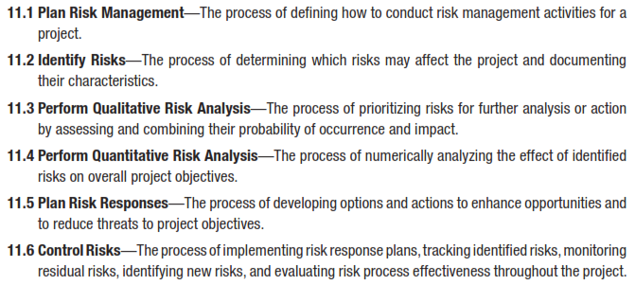
Risk Management
PROJECT Risk MANAGEMENT

Slide 17
THREE THEMES

Slide 18
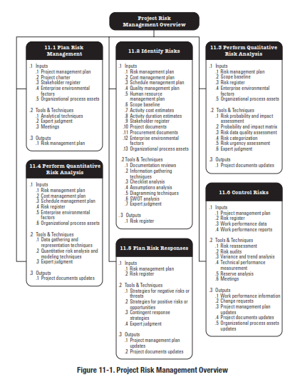

Slide 20
8
2
Plan Risk Management
Risk
Planning
Process 11.1
Process of defining how to conduct risk management activities for a project.
11.1
Inputs
1
Tools and Techniques
2
Outputs
3
Project Scope Statement
Cost Management Plan
Schedule Management Plan
Communications Management Plan
Enterprise Environmental Factors
Organizational Process Assets
____________
Planning Meetings and Analysis
___________
Risk Management Plan
____________
Reference: Figure 11.2.
PMBOK® Guide, 4th Ed
Notes:
Picture with three text columns
(Intermediate)
To reproduce the picture effects on this slide, do the following:
On the Home tab, in the Slides group, click Layout, and then click Blank.
On the Insert tab, in the Illustrations group, click Picture.
In the Insert Picture dialog box, select a picture and then click Insert.
Select the picture. Under Picture Tools, on the Format tab, in the bottom right corner of the Size group, click the Size and Position dialog box launcher.
In the Size and Position dialog box, on the Size tab, resize or crop the picture as needed so that under Size and rotate, the Height box is set to 1.48” and the Width box is set to 9.17”. Resize the picture under Size and rotate by entering values into the Height and Width boxes. Crop the picture under Crop from by entering values into the Left, Right, Top, and Bottom boxes.
On the Home tab, in the bottom right corner of the Drawing group, click the Format Shape dialog box launcher. In the Format Shape dialog box, click Line Color in the left pane, select Gradient line in the right pane, and then do the following:
In the Type list, select Linear.
Click the button next to Direction, and then click Linear Up (second row, second option from the left).
Under Gradient stops, click Add or Remove until two stops appear in the drop-down list.
Also under Gradient stops, customize the gradient stops that you added as follows:
Select Stop 1 from the list, and then do the following:
In the Stop position box, enter 0%.
Click the button next to Color, and then under Theme Colors click White, Background 1 (first row, first option from the left).
Select Stop 2 from the list, and then do the following:
In the Stop position box, enter 100%.
Click the button next to Color, and then under Theme Colors click White, Background 1, Darker 25% (fourth row, first option from the left).
Also in the Format Shape dialog box, click Line Style in the left pane, and then in the right pane, in the Width box, enter 1 pt.
On the Home tab, in the Drawing group, click Shape Effects, point to Glow, and then do the following:
Under Glow Variations, select any option in the first row (5 pt glow options).
Point to More Glow Colors, and then under Theme Colors click White, Background 1, Darker 25% (fourth row, first option from the left).
On the Home tab, in the Drawing group, click Arrange, point to Align, and then click Align Center.
To reproduce the first column heading on this slide, do the following:
On the Home tab, in the Drawing group, click Shapes, and then under Rectangles, click Rectangle (first option from the left). On the slide, drag to draw a rectangle.
Under Drawing Tools, on the Format tab, in the Size group, do the following:
In the Shape Height box, enter 1”.
In the Shape Width box, enter 2.92”.
On the Home tab, in the bottom right corner of the Drawing group, click the Format Shape dialog box launcher. In the Format Shape dialog box, click Fill in the left pane, select Gradient fill in the right pane, and then do the following:
In the Type list, select Linear.
Click the button next to Direction, and then click Linear Down (first row, second option from the left).
Under Gradient stops, click Add or Remove until two stops appear in the drop-down list.
Also under Gradient stops, customize the gradient stops that you added as follows:
Select Stop 1 from the list, and then do the following:
In the Stop position box, enter 32%.
Click the button next to Color, and then under Theme Colors click Tan, Background 2 (first row, third option from the left).
Select Stop 2 from the list, and then do the following:
In the Stop position box, enter 100%.
Click the button next to Color, and then under Theme Colors click Tan, Background 2, Darker 25% (third row, third option from the left).
Also in the Format Shape dialog box, click Line Color in the left pane, select Gradient line in the Line Color pane, and then do the following:
In the Type list, select Linear.
Click the button next to Direction, and then click Linear Up (second row, second option from the left).
Under Gradient stops, click Add or Remove until two stops appear in the drop-down list.
Also under Gradient stops, customize the gradient stops that you added as follows:
Select Stop 1 from the list, and then do the following:
In the Stop position box, enter 0%.
Click the button next to Color, and then under Theme Colors click White, Background 1 (first row, first option from the left).
Select Stop 2 from the list, and then do the following:
In the Stop position box, enter 100%.
Click the button next to Color, and then under Theme Colors click White, Background 1, Darker 25% (fourth row, first option from the left).
Also in the Format Shape dialog box, click Line Style in the left pane. In the right pane, in the Width box, enter 1 pt.
On the Home tab, in the Drawing group, click Shape Effects, point to Glow, and then do the following:
Under Glow Variations, select any option in the first row (5 pt glow options).
Point to More Glow Colors, and then under Theme Colors click White, Background 1, Darker 25% (fourth row, first option from the left).
On the slide, right-click the rectangle and then click Edit Text.
Enter text in the text box and select the text. On the Home tab, in the Font group, select Gill Sans MT from the Font list and then select 24 from the Font Size list.
On the Home tab, in the Paragraph group, click Align Text Left to align the text left within the text box.
Under Drawing Tools, on the Format tab, in the WordArt Styles group, click the arrow next to Text Fill, and then under Theme Colors click Tan, Background 2, Darker 75% (fifth row, third option from the left).
On the Home tab, in the bottom-right corner of the Drawing group, click the Format Shapes dialog box launcher. In the Format Shapes dialog box, click Text Box in the left pane. In the right pane, under Internal margin, enter 1” in the Left box to increase the left margin in the rectangle to accommodate the embossed number.
On the Home tab, in the Drawing group, click Shapes, and then under Lines, click Line (first option from the left).
Press and hold SHIFT, and then on the slide, drag to draw a straight, vertical line.
Under Drawing Tools, on the Format tab, in the Size group, in the Width box, enter 0.75”.
On the Home tab, in the bottom-right corner of the Drawing group, click the Format Shapes dialog box launcher. In the Format Shapes dialog box, click Line Style in the left pane, and then do the following in the right pane:
In the Width box, enter 2.25 pt.
Click the button next to Dash type, and then click Round Dot (second option from the top).
Also in the Format Shapes dialog box, click Line Color in the left pane. In the right pane, click the button next to Color, and then under Theme Colors click White, Background 1 (first row, first option from the left).
On the slide, drag the line onto the rectangle, just left of the text box.
On the Insert tab, in the Text box, click Text Box and then on the slide, drag to draw another text box.
Enter 1 in the text box and select the text. On the Home tab, in the Font group, select Calisto MT from the Font list and then enter 50 in the Font Size box.
On the Home tab, in the Paragraph group, click Center to center the text within the text box.
Under Drawing Tools, on the Format tab, in the WordArt Styles group, click the arrow next to Text Fill, and then under Theme Colors click Tan, Background 2, Darker 25% (third row, third option from the left).
Drag the text box onto the rectangle, left of the dotted vertical line.
On the Home tab, in the Editing group, click Select, and then click Selection Pane.
In the Selection and Visibility pane, press and hold CTRL to select the text box, line, and rectangle.
On the Home tab, in the Drawing group, click Arrange, point to Align, and then click Align Middle.
To reproduce the other column headings on this slide, do the following:
On the Home tab, in the Editing group, click Select, and then click Selection Pane.
In the Selection and Visibility pane, press and hold CTRL to select the text box, line, and rectangle.
On the Home tab, in the Drawing group, click Arrange, and then under Group Objects click Group.
On the Home tab, in the Clipboard group, click the arrow under Paste, and then click Duplicate. Repeat the process until you have a total of three groups of shapes.
Select each group in the Selection and Visibility pane and drag it on the slide to form a row under the picture.
Also in the Selection and Visibility pane, press and hold CTRL and select all three groups. On the Home tab, in the Drawing group, click Arrange, point to Align, and then do the following:
Click Align Middle.
Click Distribute Horizontally.
To change the numbers in the duplicate text boxes (second and third from the left), click in each text box and edit the text.
To reproduce the first column (the “subtext” portion) on this slide, do the following:
On the Home tab, in the Drawing group, click Shapes, and then under Rectangles click Rectangle (first option from the left).
On the slide, drag to draw the rectangle so that the top edge is just below the first column heading and the bottom edge is at the bottom of the slide.
Under Drawing Tools, on the Format tab, in the Size group, in the Shape Width box, enter 2.92” so that the subtext column is the same width as the column heading above it.
On the Home tab, in the Drawing group, click the arrow next to Shape Outline, and then click No Outline.
On the Home tab, in the bottom right corner of the Drawing group, click the Format Shape dialog box launcher. In the Format Shape dialog box, click Fill in the left pane, select Gradient fill in the right pane, and then do the following:
In the Type list, select Linear.
Click the button next to Direction, and then click Linear Down (first row, second option from the left).
Under Gradient stops, click Add or Remove until three stops appear in the drop-down list.
Also under Gradient stops, customize the gradient stops that you added as follows:
Select Stop 1 from the list, and then do the following:
In the Stop position box, enter 0%.
Click the button next to Color, and then under Theme Colors click White, Background 1 (first row, first option from the left).
In the Transparency box, enter 100%.
Select Stop 2 from the list, and then do the following:
In the Stop position box, enter 50%.
Click the button next to Color, and then under Theme Colors click Tan, Background 2, Darker 25% (third row, third option from the left).
In the Transparency box, enter 25%.
Select Stop 3 from the list, and then do the following:
In the Stop position box, enter 100%.
Click the button next to Color, and then under Theme Colors click White, Background 1 (first row, first option from the left).
In the Transparency box, enter 100%.
On the slide, right-click the column and then click Edit Text.
Enter text in the text box and select the text. On the Home tab, in the Font group, select Gill Sans MT from the Font list and then enter 22 in the Font Size box.
On the Home tab, in the Paragraph group, click Center to center the text within the rectangle.
Under Drawing Tools, on the Format tab, in the WordArt Styles group, click the arrow next to Text Fill, and then under Theme Colors click White, Background 1, Darker 50% (sixth row, first option from the left).
On the Home tab, in the bottom-right corner of the Drawing group, click the Format Shapes dialog box launcher. In the Format Shapes dialog box, click Text Box in the left pane. In the right pane, under Text layout, in the Vertical Alignment list, select Top.
To reproduce the other columns (the “subtext” portion) on this slide, do the following:
Select the first “subtext” rectangle. On the Home tab, in the Clipboard group, click the arrow under Paste, and then click Duplicate. Repeat the process until you have a total of three “subtext” rectangles.
Drag each duplicate on the slide to form a row under the “text heading” rectangles.
Press and hold SHIFT and select all three “subtext” rectangles. On the Home tab, in the Drawing group, click Arrange, point to Align, and then click Distribute Horizontally.
To reproduce the background on this slide, do the following:
Right-click the slide background area, and then click Format Background. In the Format Background dialog box, click Fill in the left pane, select Gradient fill in the right pane, and then do the following:
In the Type list, select Radial.
Click the button next to Direction, and then click From Center (third option from the left).
Under Gradient stops, click Add or Remove until two stops appear in the drop-down list.
Also under Gradient stops, customize the gradient stops that you added as follows:
Select Stop 1 from the list, and then do the following:
In the Stop position box, enter 0%.
Click the button next to Color, and then under Theme Colors click White, Background 1 (first row, first option from the left).
Select Stop 2 from the list, and then do the following:
In the Stop position box, enter 100%.
Click the button next to Color, and then under Theme Colors click Tan, Background 2 (first row, third option from the left).

Slide 21
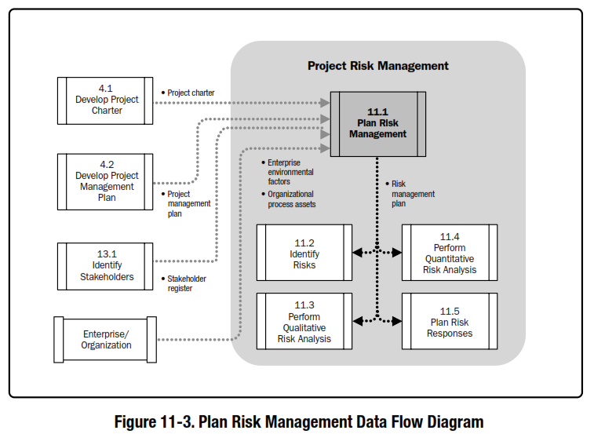
Reference: Figure 11.3.
PMBOK® Guide, 5th Ed

Slide 22
Risk Management Plan
Methodology – defines approaches, tools, and data sources that might be used to perform risk management on the project
Roles & Responsibilities – defines the lead, support, and risk management team membership for each type of action in the plan
Budget - $
Timing – Describes how often the risk management process will be performed throughout the project life cycle.
Scoring and interpretation – methods used for performing qualitative and quantitative risk analysis
Thresholds – the target against which the project team measures the effectiveness of the the risk response plan execution
Reporting formats - defines how the results of the risk management processes will be documented, analyzed, and communicated to the project team and stakeholders
Tracking – Documents all facets of risk activities and how the risk process will be audited

Slide 23
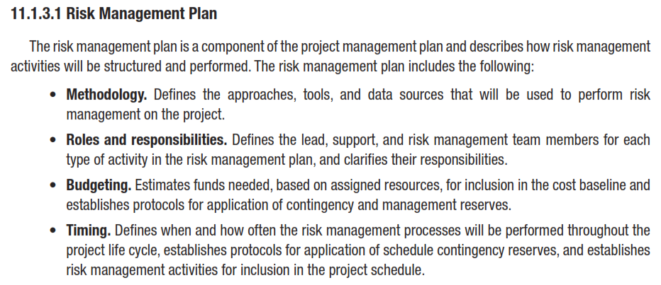
Risk Management Plan

Slide 24
Risk Management Plan

Slide 25
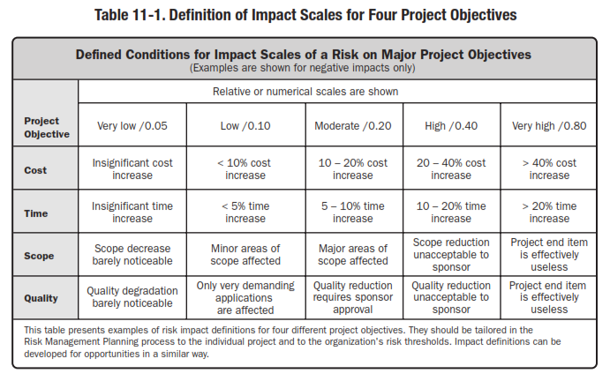

Slide 26
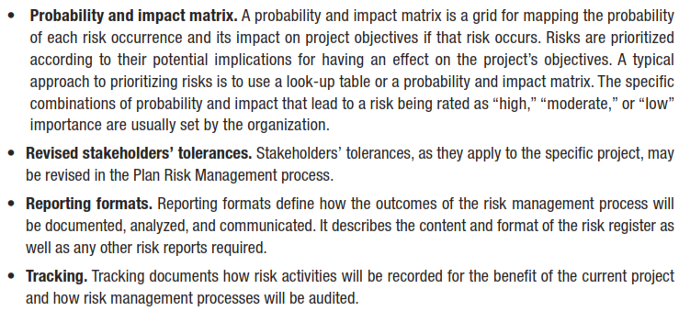

Slide 27
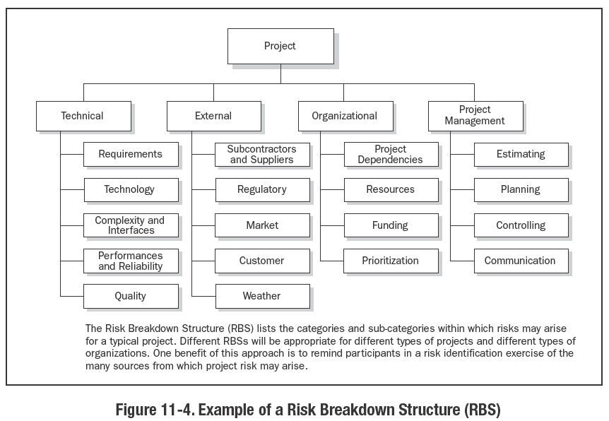

Slide 28
Introduction to Risk
Risk – Events or consequences that have the probability of occurring during a project and that are measured by their impacts on the project
Components
Risk event
Risk event probability
Risk outcome or consequence
(Amount at stake)
Risk event status
(Probability x amount at stake)

Slide 29
Risk Management Plan
Methodology – defines approaches, tools, and data sources that might be used to perform risk management on the project
Roles & Responsibilities – defines the lead, support, and risk management team membership for each type of action in the plan
Budget - $
Timing – Describes how often the risk management process will be performed throughout the project life cycle.
Scoring and interpretation – methods used for performing qualitative and quantitative risk analysis
Thresholds – the target against which the project team measures the effectiveness of the the risk response plan execution
Reporting formats - defines how the results of the risk management processes will be documented, analyzed, and communicated to the project team and stakeholders
Tracking – Documents all facets of risk activities and how the risk process will be audited

Slide 30
UNIT 6
PLAN RISK MANAGEMENT PROCESS
Critical Success Factors

Slide 31
PLAN RISK MANAGEMENT PROCESS
Success Criteria
Critical Success Factors
UNIT 6
There are two categories of success criteria for the risk management
Those for success of the project in general
Those for success of Project Risk Management
4.2.2 Involve Project Stakeholders in Project Risk Management
4.2.3 Comply with the Organization’s Objectives, policies, and Practices
From Practice Standard for Project Risk Management, 1st Ed, PMI
Notes:
ROLE OF PROJECT RISK MGMT
In Corporate Business Management
Two Basic Types in Corporate Business Management:-
Business Risk
Inherent chances of both profit and loss associated with the particular business endeavor.
Business entities employ skilled staff to increase the chances of profit and reduce the chances of loss.
The essential purpose is to maximize profits.
Pure or Insurable Risk
Involves only a chance for loss and no chance for profit.
Insurable risks can be further sub-divided into four categories:-
Direct property loss
Indirect property loss
Liability loss
Personal loss

Slide 32
PLAN RISK MANAGEMENT PROCESS
Involve Project Stakeholders
UNIT 6
The project manager needs to involve the project stakeholders in the Plan Risk Management activities
To build on their skills and experiences as well as
To ensure their understanding of, and commitment to, the full Project Risk Management process.
From Practice Standard for Project Risk Management, 1st Ed, PMI
Notes:
ROLE OF PROJECT RISK MGMT
In Corporate Business Management
Two Basic Types in Corporate Business Management:-
Business Risk
Inherent chances of both profit and loss associated with the particular business endeavor.
Business entities employ skilled staff to increase the chances of profit and reduce the chances of loss.
The essential purpose is to maximize profits.
Pure or Insurable Risk
Involves only a chance for loss and no chance for profit.
Insurable risks can be further sub-divided into four categories:-
Direct property loss
Indirect property loss
Liability loss
Personal loss

Slide 33
PLAN RISK MANAGEMENT PROCESS
Involve Project Stakeholders
UNIT 6
The provision of risk management resources specified within the risk management plan should be approved by management at a level adequate for carrying out the required Project Risk Management processes in accordance with agreed-upon objectives.
Management should be involved in the analysis of the level of resourcing required for managing project risk and accept the risks that may arise from specific limitations placed on the provision of resources.
Disagreements between stakeholders in the areas of risk tolerance and evaluation measures should be addressed and resolved.
From Practice Standard for Project Risk Management, 1st Ed, PMI
Notes:
ROLE OF PROJECT RISK MGMT
In Corporate Business Management
Two Basic Types in Corporate Business Management:-
Business Risk
Inherent chances of both profit and loss associated with the particular business endeavor.
Business entities employ skilled staff to increase the chances of profit and reduce the chances of loss.
The essential purpose is to maximize profits.
Pure or Insurable Risk
Involves only a chance for loss and no chance for profit.
Insurable risks can be further sub-divided into four categories:-
Direct property loss
Indirect property loss
Liability loss
Personal loss

Slide 34
PLAN RISK MANAGEMENT PROCESS
Organizational Compliance
UNIT 6
The feasibility of risk management planning is dependent upon the features of the organization in which it is carried out.
The rules and guidelines defined in the risk management plan should be compatible with the
culture of the organization,
its capabilities from the point of view of people and facilities, and
its values, goals and objectives.
From Practice Standard for Project Risk Management, 1st Ed, PMI
Notes:
ROLE OF PROJECT RISK MGMT
In Corporate Business Management
Two Basic Types in Corporate Business Management:-
Business Risk
Inherent chances of both profit and loss associated with the particular business endeavor.
Business entities employ skilled staff to increase the chances of profit and reduce the chances of loss.
The essential purpose is to maximize profits.
Pure or Insurable Risk
Involves only a chance for loss and no chance for profit.
Insurable risks can be further sub-divided into four categories:-
Direct property loss
Indirect property loss
Liability loss
Personal loss

Slide 35
PLAN RISK MANAGEMENT PROCESS
Organizational Compliance
UNIT 6
Project management in general, and
risk management in particular,
contribute to the organization’s effective governance.
The risk management plan should
identify and take into account
the relevant organizational procedures and
any other enterprise environmental factors
that apply such as
strategic risk management or
corporate governance processes.
From Practice Standard for Project Risk Management, 1st Ed, PMI
Notes:
ROLE OF PROJECT RISK MGMT
In Corporate Business Management
Two Basic Types in Corporate Business Management:-
Business Risk
Inherent chances of both profit and loss associated with the particular business endeavor.
Business entities employ skilled staff to increase the chances of profit and reduce the chances of loss.
The essential purpose is to maximize profits.
Pure or Insurable Risk
Involves only a chance for loss and no chance for profit.
Insurable risks can be further sub-divided into four categories:-
Direct property loss
Indirect property loss
Liability loss
Personal loss

Slide 36
UNIT 6
PLAN RISK MANAGEMENT PROCESS
Tools and Techniques

Slide 37
PLAN RISK MANAGEMENT PROCESS
Tools and Techniques
UNIT 6
4.3.1 Planning Sessions
4.3.2 Templates
From Practice Standard for Project Risk Management, 1st Ed, PMI
Notes:
ROLE OF PROJECT RISK MGMT
In Corporate Business Management
Two Basic Types in Corporate Business Management:-
Business Risk
Inherent chances of both profit and loss associated with the particular business endeavor.
Business entities employ skilled staff to increase the chances of profit and reduce the chances of loss.
The essential purpose is to maximize profits.
Pure or Insurable Risk
Involves only a chance for loss and no chance for profit.
Insurable risks can be further sub-divided into four categories:-
Direct property loss
Indirect property loss
Liability loss
Personal loss

Slide 38
PLAN RISK MANAGEMENT PROCESS
Planning Sessions - Purpose
UNIT 6
Planning Sessions are recommended in order
To build a common understanding of the project’s risk approach between project stakeholders and
To gain agreement on the techniques to be used for managing risk.
Elaboration of the risk management plan often serves
To develop an effective means for the team to work together since a similar consultative team approach will be used in subsequent stages of the risk management process.
From Practice Standard for Project Risk Management, 1st Ed, PMI
Notes:
ROLE OF PROJECT RISK MGMT
In Corporate Business Management
Two Basic Types in Corporate Business Management:-
Business Risk
Inherent chances of both profit and loss associated with the particular business endeavor.
Business entities employ skilled staff to increase the chances of profit and reduce the chances of loss.
The essential purpose is to maximize profits.
Pure or Insurable Risk
Involves only a chance for loss and no chance for profit.
Insurable risks can be further sub-divided into four categories:-
Direct property loss
Indirect property loss
Liability loss
Personal loss

Slide 39
PLAN RISK MANAGEMENT PROCESS
Planning Sessions - Participants
UNIT 6
The participants should include:
the project manager,
selected project team members and
the stakeholders,
members of the broader organization having responsibility for risk, and
other subject matter experts or
facilitators
as needed.
From Practice Standard for Project Risk Management, 1st Ed, PMI
Notes:
ROLE OF PROJECT RISK MGMT
In Corporate Business Management
Two Basic Types in Corporate Business Management:-
Business Risk
Inherent chances of both profit and loss associated with the particular business endeavor.
Business entities employ skilled staff to increase the chances of profit and reduce the chances of loss.
The essential purpose is to maximize profits.
Pure or Insurable Risk
Involves only a chance for loss and no chance for profit.
Insurable risks can be further sub-divided into four categories:-
Direct property loss
Indirect property loss
Liability loss
Personal loss

Slide 40
PLAN RISK MANAGEMENT PROCESS
Planning Sessions - Assign
UNIT 6
At this point, the
initial risk responsibility,
methodology,
templates,
terms,
definitions,
time schedule, and
cost budgets
for the other Project Risk Management processes should be assigned and accepted.
From Practice Standard for Project Risk Management, 1st Ed, PMI
Notes:
ROLE OF PROJECT RISK MGMT
In Corporate Business Management
Two Basic Types in Corporate Business Management:-
Business Risk
Inherent chances of both profit and loss associated with the particular business endeavor.
Business entities employ skilled staff to increase the chances of profit and reduce the chances of loss.
The essential purpose is to maximize profits.
Pure or Insurable Risk
Involves only a chance for loss and no chance for profit.
Insurable risks can be further sub-divided into four categories:-
Direct property loss
Indirect property loss
Liability loss
Personal loss

Slide 41
PLAN RISK MANAGEMENT PROCESS
Planning Sessions - Tools
UNIT 6
The specification for the tools that will be used in subsequent processes should include
all parameters and
other inputs
required to ensure applicability to the specific project.
These should be documented in the risk management plan, which, when formally approved, is the principal deliverable of the Plan Risk Management process.
From Practice Standard for Project Risk Management, 1st Ed, PMI
Notes:
ROLE OF PROJECT RISK MGMT
In Corporate Business Management
Two Basic Types in Corporate Business Management:-
Business Risk
Inherent chances of both profit and loss associated with the particular business endeavor.
Business entities employ skilled staff to increase the chances of profit and reduce the chances of loss.
The essential purpose is to maximize profits.
Pure or Insurable Risk
Involves only a chance for loss and no chance for profit.
Insurable risks can be further sub-divided into four categories:-
Direct property loss
Indirect property loss
Liability loss
Personal loss

Slide 42
PLAN RISK MANAGEMENT PROCESS
Templates
UNIT 6
In order to benefit from experience and existing best practice, risk management planning should take into account relevant existing templates for work products, such as
risk status reports,
risk breakdown structures or
the risk register.
A decision should be made as to which templates are relevant to the project, and these should then be adapted and included in the risk management plan.
From Practice Standard for Project Risk Management, 1st Ed, PMI
Notes:
ROLE OF PROJECT RISK MGMT
In Corporate Business Management
Two Basic Types in Corporate Business Management:-
Business Risk
Inherent chances of both profit and loss associated with the particular business endeavor.
Business entities employ skilled staff to increase the chances of profit and reduce the chances of loss.
The essential purpose is to maximize profits.
Pure or Insurable Risk
Involves only a chance for loss and no chance for profit.
Insurable risks can be further sub-divided into four categories:-
Direct property loss
Indirect property loss
Liability loss
Personal loss

Slide 43
UNIT 6
PLAN RISK MANAGEMENT PROCESS
Documenting the Results

Slide 44
PLAN RISK MANAGEMENT PROCESS
Documenting the Results
UNIT 6
The results of risk management planning are documented in the risk management plan.
The plan serves to provide all project stakeholders with a common view of
how the risk-related activities of the project will be handled,
what has been agreed upon, and
a description of the stakeholders’ involvement and responsibilities in these activities.
From Practice Standard for Project Risk Management, 1st Ed, PMI
Notes:
ROLE OF PROJECT RISK MGMT
In Corporate Business Management
Two Basic Types in Corporate Business Management:-
Business Risk
Inherent chances of both profit and loss associated with the particular business endeavor.
Business entities employ skilled staff to increase the chances of profit and reduce the chances of loss.
The essential purpose is to maximize profits.
Pure or Insurable Risk
Involves only a chance for loss and no chance for profit.
Insurable risks can be further sub-divided into four categories:-
Direct property loss
Indirect property loss
Liability loss
Personal loss

Slide 45
PLAN RISK MANAGEMENT PROCESS
Key Areas of Focus
UNIT 6
People | Tools | Business
Attitudes | Toolbox | Constraints
Roles, responsibilities, authority | Parameters | Amount of detail and effort
Communications | Definitions
From Practice Standard for Project Risk Management, 1st Ed, PMI
Notes:
ROLE OF PROJECT RISK MGMT
In Corporate Business Management
Two Basic Types in Corporate Business Management:-
Business Risk
Inherent chances of both profit and loss associated with the particular business endeavor.
Business entities employ skilled staff to increase the chances of profit and reduce the chances of loss.
The essential purpose is to maximize profits.
Pure or Insurable Risk
Involves only a chance for loss and no chance for profit.
Insurable risks can be further sub-divided into four categories:-
Direct property loss
Indirect property loss
Liability loss
Personal loss

Slide 46
PLAN RISK MANAGEMENT PROCESS
Elements to Include
UNIT 6
Depending upon the size and complexity of the project. Some or all of the following elements will be present in a risk management plan:-
Introduction
Project description
Risk management methodology
Risk management organization
Roles, responsibility and authority
Stakeholder risk tolerance
Criteria for success
Risk management tools and guidelines for use
Thresholds and corresponding definitions
Templates
Communication plan
Strategy
Risk breakdown structure
From Practice Standard for Project Risk Management, 1st Ed, PMI
Notes:
ROLE OF PROJECT RISK MGMT
In Corporate Business Management
Two Basic Types in Corporate Business Management:-
Business Risk
Inherent chances of both profit and loss associated with the particular business endeavor.
Business entities employ skilled staff to increase the chances of profit and reduce the chances of loss.
The essential purpose is to maximize profits.
Pure or Insurable Risk
Involves only a chance for loss and no chance for profit.
Insurable risks can be further sub-divided into four categories:-
Direct property loss
Indirect property loss
Liability loss
Personal loss

Slide 47
UNIT 6
Review Questions

Slide 48
The End
THE END
THANK YOU

